Slide 1

BIKE SALES: GROWTH STRATEGY

Slide 2

BIKE SALES PRESENTATION
In this presentation, we'll unpack the vital patterns within our bike sales data to understand our customer base more deeply. By analyzing purchasing behavior across various demographics and geographical areas, we've identified key opportunities to refine our approach and enhance sales performance through targeted strategies.

Slide 3

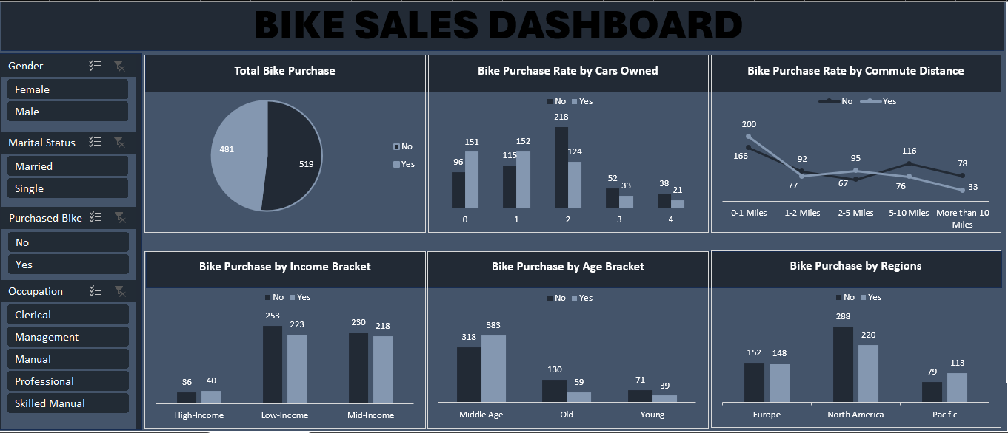

Slide 4

KEY INSIGHTS
Based on our analysis of 1000 customer records, the following insights emerge regarding bike purchase behavior:
Overall Purchase Demographics: 48.1% of our customer base (481 customers) made a bike purchase. Among these purchasers, male customers (242) slightly outnumber female customers (239). The remaining 51.9% (519 customers) made no bike purchases.
Car Ownership Impact: Customers owning 0-2 cars exhibit a significantly higher bike purchase rate compared to those owning 3-4 cars, indicating an inverse relationship between car ownership and bike purchases.
Commute Distance Correlation: A clear inverse correlation exists between commute distance and bike purchases. Customers with commute distances of 0-1 mile show the highest bike purchase rates, which decline significantly as commute distances increase.

Slide 5
KEY INSIGHTS
Income Segment Performance: Most bike purchases originate from customers in the Low to Mid-income brackets. High-income customers represent a notably smaller proportion of total bike purchases.
Age Bracket Sweet Spot: The middle-age bracket accounts for the highest volume of bike purchases, significantly outperforming both younger and older customer segments.
Geographic Sales Concentration: North America is our strongest sales region, followed by Europe, with the Pacific region showing the lowest sales volume.
5

Slide 6
RECOMMENDATION
1. Address High-Income Customer Gap:
Recommendation: Investigate specific reasons for low bike purchase rates among high-income customers. This could involve surveys, focus groups, or market research. Based on findings, we could consider introducing premium, luxury, or specialized (e.g., high-performance road bikes, electric bikes) offerings with associated marketing that aligns with their lifestyle and preferences.
Rationale: This segment represents an untapped market. Understanding their barriers (e.g., lack of perceived need, preference for high-end alternatives) is crucial to unlocking potential revenue.
2. Geographic Expansion & Optimization:
Recommendation: Analyze market saturation and growth potential within North America to maximize existing strengths. Simultaneously, develop specific growth strategies for Europe, focus on replicating successful North American tactics where applicable, and conducting further market research in the Pacific region to understand unique challenges and opportunities before significant investment.
Rationale: Prioritizing efforts where current sales are strongest allows for efficient resource allocation, while strategic planning for lower-performing regions ensures future growth.
3. Gender-Specific Marketing Refinement:
Recommendation: While males slightly out-purchase females, investigate subtle marketing adjustments to appeal more broadly to female customers, ensuring product presentation and messaging are inclusive and represent diverse cycling interests.
Rationale: A slight imbalance suggests potential to increase female participation without alienating the male base. Small adjustments could yield incremental sales.

Slide 7
RECOMMENDATION
4. Target Low-to-Mid Car Owners & Short Commuters:
Recommendation: Develop targeted marketing campaigns (digital ads, local promotions) specifically aimed at individuals with 0-2 cars, particularly those residing in urban or suburban areas with short commute distances (0-1 mile).
Rationale: This segment demonstrates the highest propensity for bike purchases and represents an immediate growth opportunity. We should focus our message on convenience, health benefits for short commutes, and environmental advantages of biking over short drives.
5. Strategic Focus on Mid-Income & Middle-Aged Demographics:
Recommendation: Tailor product offerings and marketing messages to resonate with the values and needs of the Low to Mid-income and middle-aged customer groups. Consider introducing more accessible price points or financing options for these segments.
Rationale: These groups are currently our strongest purchasing segments. We being able to understand their specific needs (e.g., family-friendly bikes, e-bikes for easier commutes, leisure biking) can further solidify and expand this core customer base.

Slide 8




THANK YOU!
Sidney Okoro
sidneyokoro11@gmail.com
07061666447

